Slide 1
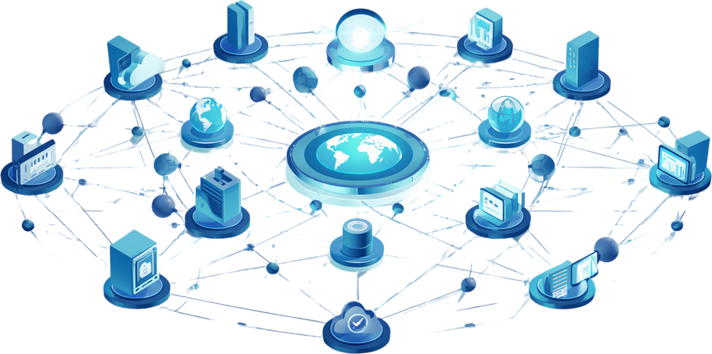
MODULE I: INTRODUCTION TO WEB AND INTERNET FUNDAMENTALS
Prepared By: Pooja Mishra

Slide 2
MODULE OVERVIEW
1: Evolution of the Web
2: AI in Web Architecture
3: Web Protocols
4: Industry Trends
2

Slide 3

1. Evolution of the Web
WHAT IS THE INTERNET?
The Internet is a worldwide network that connects computers, phones, servers, and other devices over TCP/IP, so they can communicate and share information with each other.
In simple words:
Internet = A huge network that connects devices around the world.
Simple Example 🌐
When you open YouTube on your phone:
Your Phone → Internet → YouTube Server → Internet → Your Phone
The internet carries the request from your phone to YouTube's server and brings the video back to your phone.
3

Slide 4
What can we do using the Internet?
🔎 Search for information
📧 Send emails
💬 Chat with people
🎥 Watch videos
🛒 Shop online
💰 Make online payments
🎮 Play online games
📱 Use social media
📚 Attend online classes
4

Slide 5
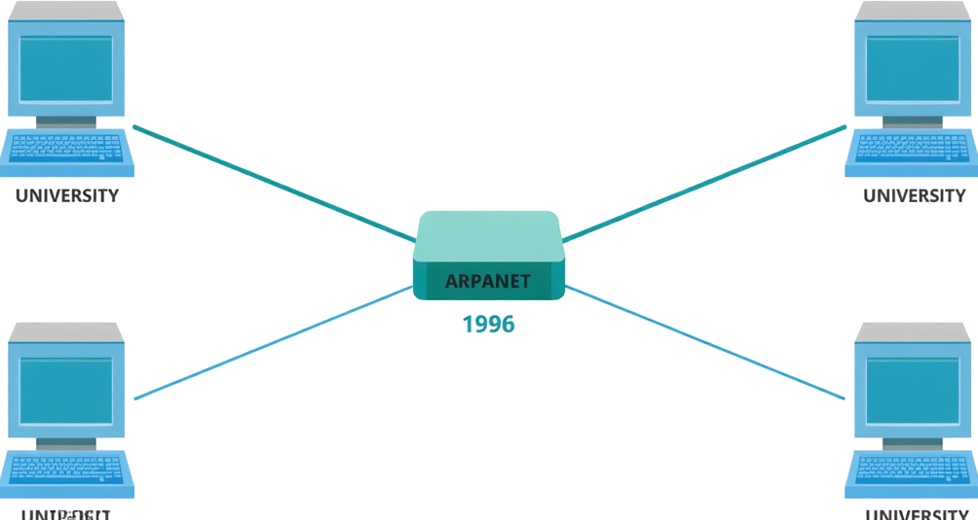
ARPANET: THE BEGINNING OF THE INTERNET
In 1969, ARPANET was created, marking the beginning of the Internet.
The U.S. Department of Defense’s Advanced Research Projects Agency (ARPA) funded the creation of ARPANET, the first practical implementation of the concept of an interconnected network.
ARPANET connected four university computers (UCLA, UCSB, Stanford Research Institute, and the University of Utah) and was used to share research and communicate.
The first message sent on ARPANET was "LO" (intended to be "LOGIN"), but the system crashed after just two letters were transmitted.
5

Slide 6




WEB 1.0: THE READ-ONLY WEB (1991–2004)
Advantages:
Fast loading
Simple structure
Easy to host
Low bandwidth usage
Disadvantages:
No user interaction,
No content updates by users,
No personalization,
No dynamic features or databases.
What It Is: Static websites built with basic HTML pages.
No user interaction or dynamic content — users could only read information.
Example: A college website displaying admission details with no forms or logins.
6

Slide 7


WEB 2.0: THE READ-WRITE WEB (2004+)
Users became content creators — not just consumers.
Social media platforms like Facebook, YouTube, Wikipedia, and Instagram emerged, enabling comments, likes, user accounts, and shared content.
The web became dynamic, interactive, and community-driven.
Key Technologies: HTML, CSS, JavaScript, AJAX, PHP, MySQL.
These technologies enabled real-time updates, rich user interfaces, and database-driven content — transforming static pages into fully interactive web applications and social experiences.
7

Slide 8


WEB 3.0: THE SEMANTIC & AI-POWERED WEB(2010+)
Machines Understand Data & Context:
Uses semantic technologies, AI, and machine learning to understand the meaning and relationships within web data and provide more intelligent experiences.
Examples: semantic search, recommendation systems, and AI assistants.
Key Advantages:
Personalized and context-aware search
Intelligent recommendations
Better data integration and interoperability
Machine-readable web information
More intelligent user experiences
8

Slide 9
WEB 4.0: THE INTELLIGENT WEB (2010s–Present, Emerging)
Key Features:
AI is embedded across digital experiences.
IoT connects physical and digital worlds.
Voice interaction enables natural communication.
Real-time personalization adapts to users.
Real-World Examples:
Self-driving cars
Smart homes
Intelligent healthcare monitoring
AI-powered personal assistants
9

Slide 10
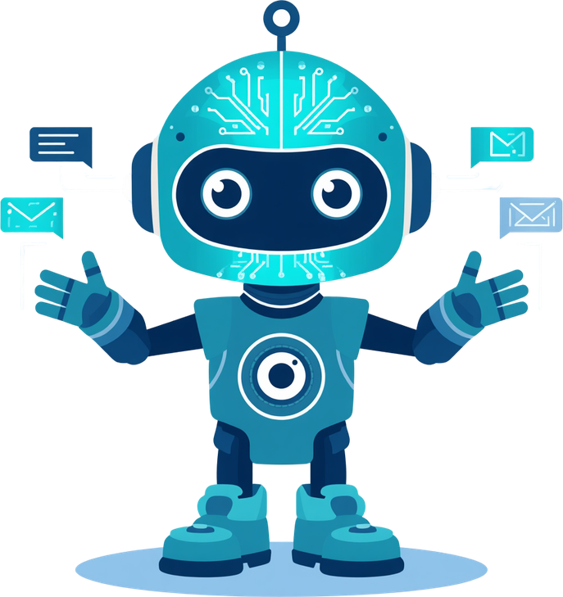
2: AI IN WEB ARCHITECTURE
What is Artificial Intelligence (AI) in Web Architecture?
AI in Web Architecture is the integration of artificial intelligence and machine-learning technologies into web applications to provide intelligent, automated, personalized, and context-aware services.
10

Slide 11
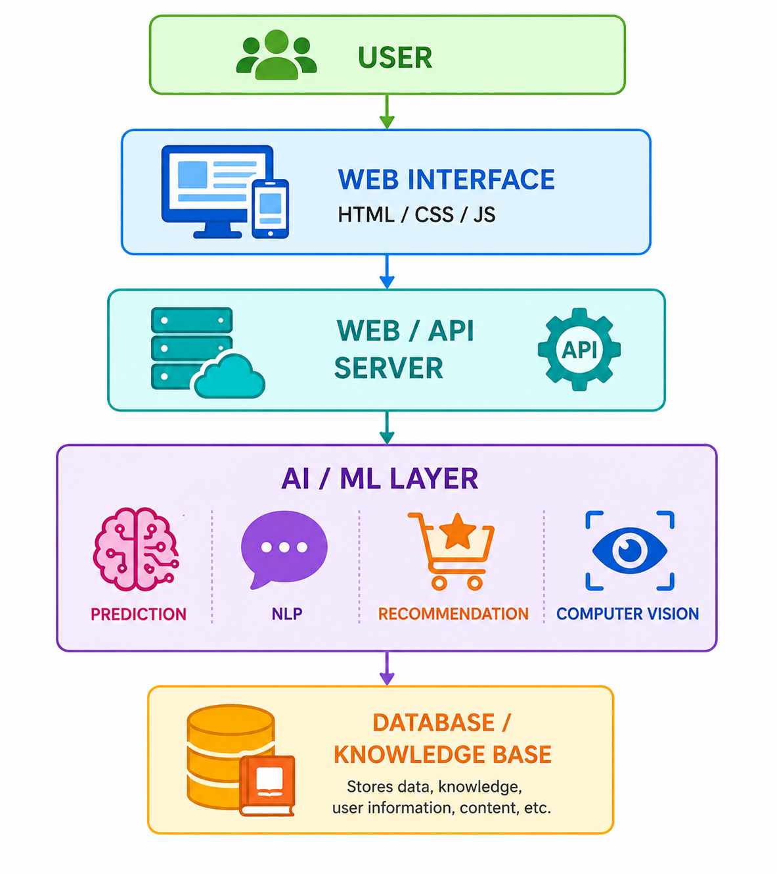
1. User
The person who interacts with the web application using a computer, laptop, tablet, or smartphone.
Search for information.
Give commands through text or voice.
Upload images or files
2. Web Interface
HTML, CSS, JavaScript
Displays AI-generated results.
Allows users to interact with AI features.
3. Web/Application Server
Receives user requests.
Communicates with databases and AI models.
Handles business logic.
Main Components in Web Architecture
4. AI/ML Layer
This is the intelligent part of the architecture.
It can perform:
Natural Language Processing (NLP) → understand text and questions.
Machine Learning → predict user behavior.
Recommendation → suggest products, videos, or content.
Computer Vision → understand images and videos.
Generative AI → generate text, images, code, etc.
5. Database / Knowledge Base Stores:
User information
Historical data
Product information
Content
AI training or retrieval data
Fig. AI in Web Architecture
11

Slide 12
AI APPLICATIONS IN WEB
Application | How AI is Used | Example
💬 Chatbots & Virtual Assistants | Understand user questions and provide responses | Customer-support chatbots, AI assistants
🔍 Intelligent Search | Understand the meaning and intent behind queries | Semantic search
🎯 Recommendation Systems | Analyze user behavior and suggest relevant content | YouTube/Netflix recommendations
🛒 E-Commerce | Recommend products and personalize shopping | Product recommendations
🗣️ Natural Language Processing | Understand and process human language | Text analysis, translation
12

Slide 13
CLIENT-SERVER MODEL: DEFINITIONS
The Client-Server Model is a network architecture in which two main components, the client and the server, communicate with each other.
Client:
A device or application that requests services from a server.
Common examples include web browsers such as Google Chrome, Mozilla Firefox, and Microsoft Edge, mobile applications or desktop application.
The client initiates communication by sending requests over the network.
Server:
A system that provides services or resources in response to client requests.
Common web server software includes Apache, Nginx, and IIS (Internet Information Services).
Servers process requests and return the appropriate response.
13

Slide 14
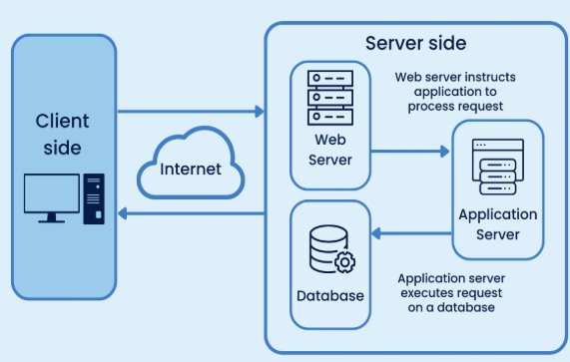
CLIENT-SERVER ARCHITECTURE
Client: User’s device/browser sends a request & displays the webpage
Internet: Transfers the request between client and server.
Web Server: Receives the request and forwards it for processing.
Application Server: Processes the request and applies business logic.
Database: Stores and retrieves the required data.
Response: The processed result is sent back to the client through the Internet.
Flow:
Client → Internet → Web Server → Application Server → Database → Response → Client
14

Slide 15
ADVANTAGES OF CLIENT- SERVER MODEL
Centralized Data Management – Data is stored and managed centrally on the server.
Easy Maintenance – Updates and maintenance can be performed mainly on the server.
Better Security – Access to data and resources can be controlled by the server.
Resource Sharing – Multiple clients can share common resources and services.
Scalability – More clients can be added as the system grows.
Data Backup – Centralized data makes backup and recovery easier.
Efficient Management – The server manages requests and resources for multiple clients.
Cost Effective – Clients do not need to store or process all data locally.
15

Slide 16
Browser & Server Communication
It is a specific example of the Client–Server Model, where the client is a browser.
Web Browsers are client applications used to access web content.
Popular browsers include Google Chrome, Mozilla Firefox, Microsoft Edge, and Safari.
They interpret and render HTML, CSS, and JavaScript to display web pages.
Web Servers store and serve all resources needed to display a website.
This includes HTML files, CSS stylesheets, JavaScript scripts, images and media files, and database-connected dynamic content.
16

Slide 17
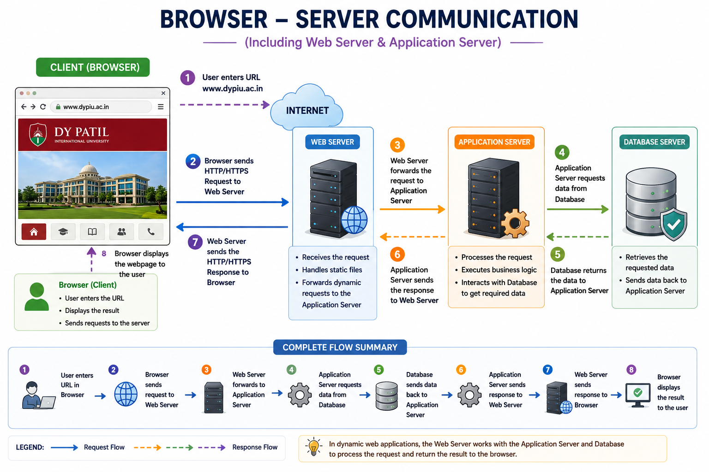
17

Slide 18
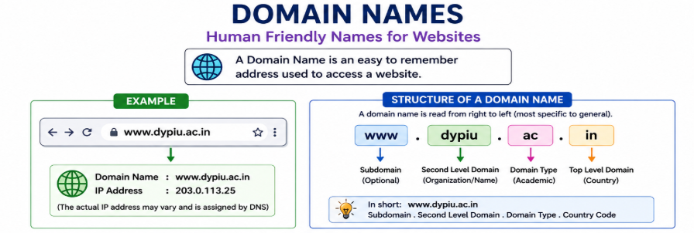
Domain Name
18

Slide 19
Domain Name System
DNS stands for Domain Name System. It is a distributed naming system that translates human-readable domain names into IP addresses
Why Do We Need DNS?
Every server reachable on the Internet has an IP address, but remembering IP addresses for every website would be difficult.
For example:
Human-friendly:
www.example.com
Computer/network-friendly:
93.184.216.34
Instead of asking users to remember numbers, DNS lets them use meaningful names.
So:
Domain Name → easy for humans
IP Address → used for network communication

Slide 20
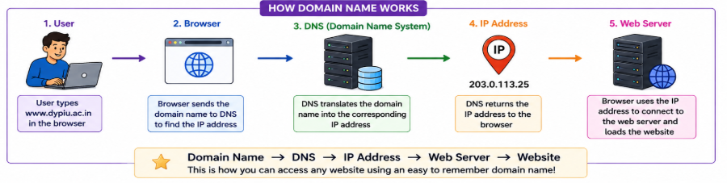

Slide 21
What is a Web Protocol?
A web protocol is a set of rules that defines how a web browser and a web server communicate with each other over the internet.
The two important web protocols are:
1) HTTP – HyperText Transfer Protocol
2) HTTPS – HyperText Transfer Protocol Secure

Slide 22
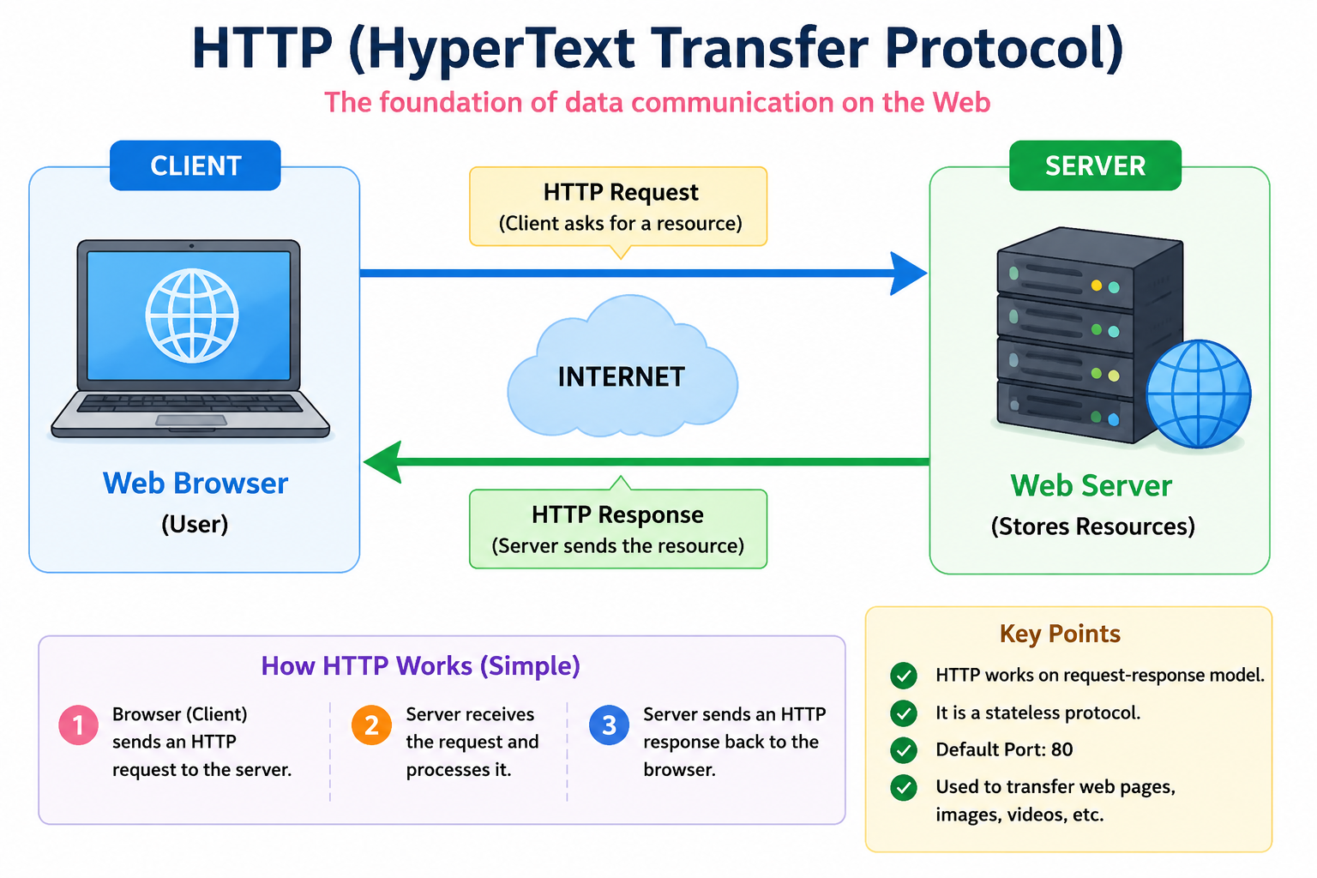
1. HTTP
HTTP stands for HyperText Transfer Protocol.
It is used to transfer web resources such as HTML pages, images, videos, CSS files, and JavaScript files between a client (browser) and a web server.

Slide 23
Important features of HTTP:
Used for communication between browser and server.
It follows a request-response model.
HTTP itself does not encrypt the data.
Usually uses port 80.
Data can potentially be intercepted while traveling across the network.

Slide 24
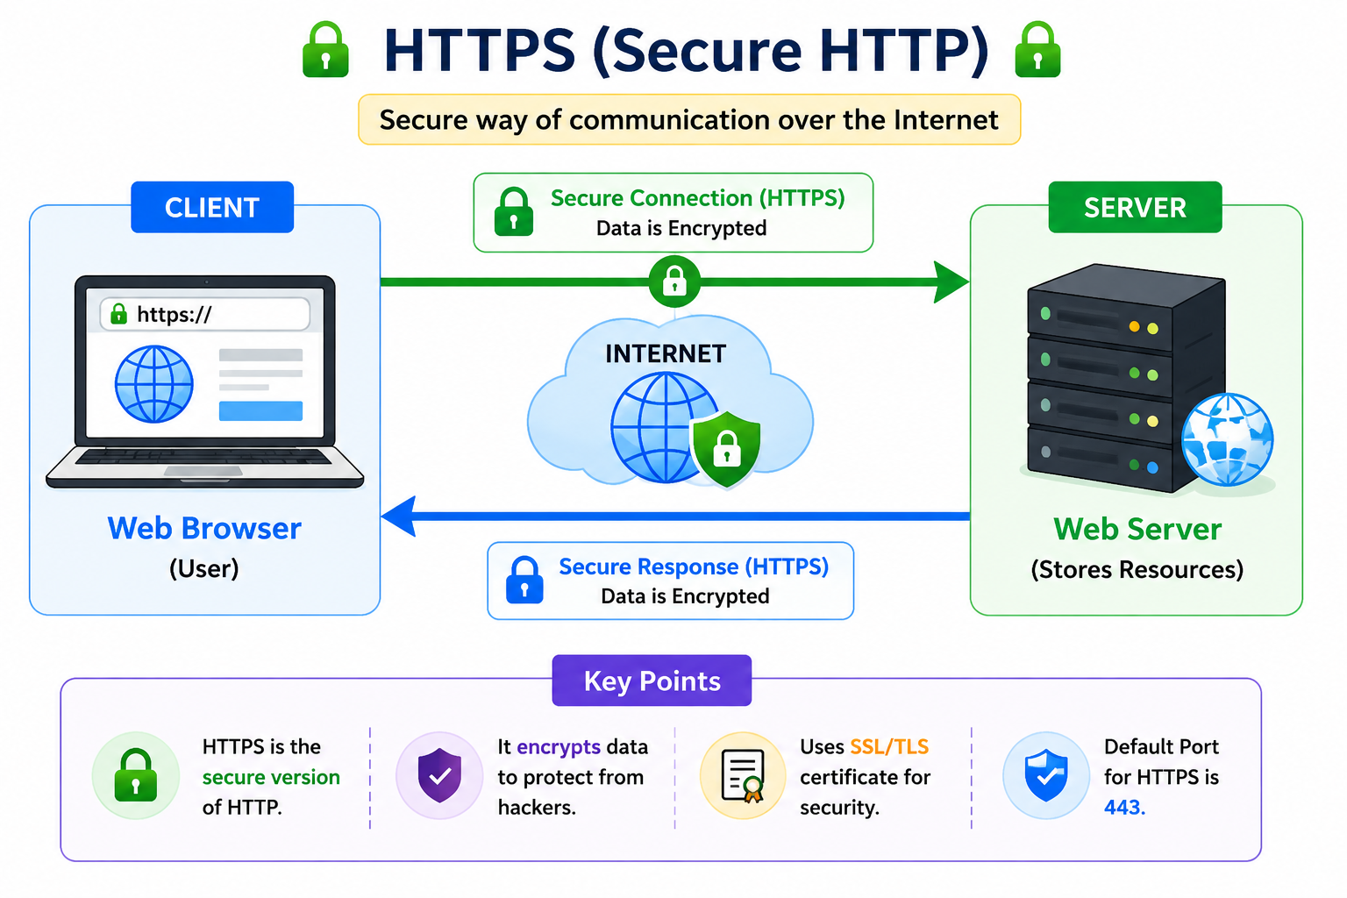
HTTPS stands for HyperText Transfer Protocol Secure.
It is the secure version of HTTP.
HTTPS uses TLS (Transport Layer Security) to encrypt communication between the browser and the server.
2. HTTPS

Slide 25
Important features of HTTPS
Encrypts communication between client and server.
Helps protect passwords, payment information, and other sensitive data.
Uses TLS certificates to authenticate the server and establish secure communication.
Usually uses port 443.
Helps protect against attackers reading or modifying data in transit.

Slide 26
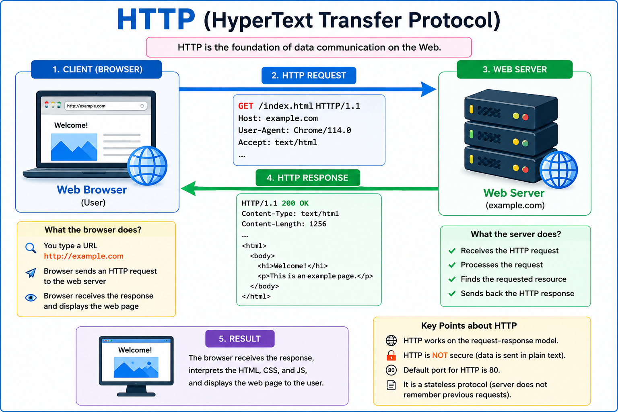
HTTP Request Response Cycle

Slide 27
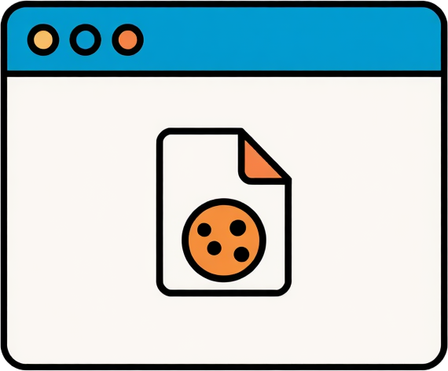
COOKIES
A cookie is a small piece of data that a website stores in the user's web browser. It helps the website remember information about the user, such as login status, preferences, or shopping-cart items.
Example
Suppose you log in to a shopping website.
The server may send a cookie containing an identifier such as:
user_id = 12345
Your browser stores it. When you visit the website again, the browser can send that cookie with the request, allowing the website to recognize the relevant session or preferences.
28

Slide 28
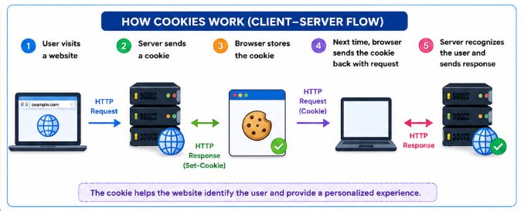

Slide 29
Common uses of cookies
🔐 Session management – keeping you logged in
⚙️ Preferences – remembering language or theme
🛒 Shopping carts – remembering items
📊 Analytics – understanding website usage
🎯 Personalization – showing relevant content

Slide 30
Types of Cookies
1. Session Cookies
Session cookies are temporary cookies used only during a browsing session.
Stored temporarily in the browser.
Usually deleted when the browsing session ends.
Commonly used for login sessions and shopping carts.
Example:
You log in to a website → a session cookie keeps you logged in while you browse.
2. Persistent Cookies
Persistent cookies remain stored in the browser for a specified period, even after the browser is closed.
Have an expiration date.
Used to remember preferences and settings.
Can keep information for days, months, or longer depending on the website's settings.
Example:
A website remembers your selected language or theme when you return later.

Slide 31
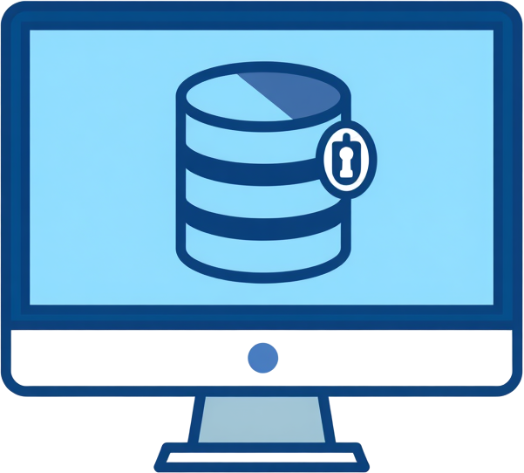
SESSIONS
A session is a temporary connection or interaction between a client and a web server that helps the server maintain information about a user across multiple requests.
29

Slide 32
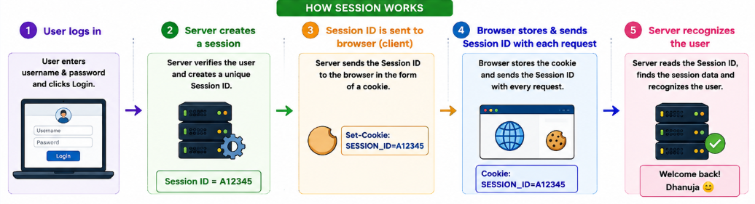

Slide 33
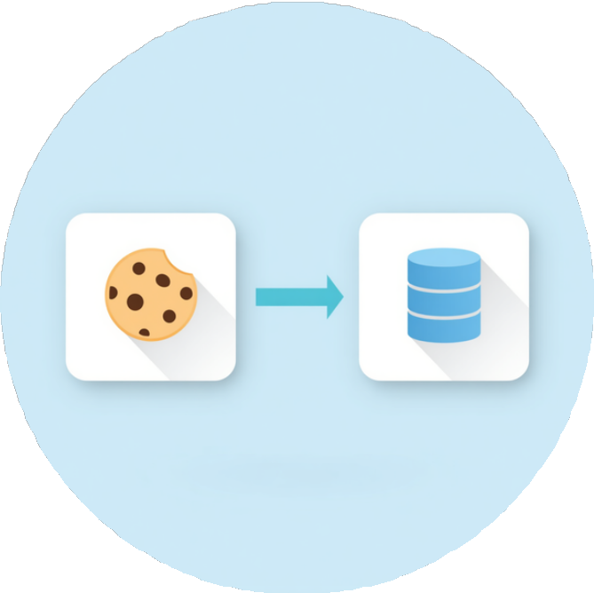
COOKIES VS SESSIONS
🍪 Cookies
Storage: Browser (client-side)
Security: Less secure, visible to client
Lifespan: Persistent (set expiry date)
Use Cases: Login memory, preferences, shopping cart
🖥 Sessions
Storage: Server (server-side)
Security: More secure, hidden from client
Lifespan: Temporary (ends when browser closes)
Use Cases: Login authentication, banking, online exams
30

Slide 34
4: INDUSTRY TRENDS
Cloud-Native Applications • Semantic Web • Web 3.0 • Blockchain Basics
31

Slide 35
INDUSTRY TRENDS IN WEB TECHNOLOGY
Modern web applications are moving beyond traditional client-server systems toward scalable, intelligent and distributed architectures.
1. Cloud-Native Applications
Applications designed to exploit cloud capabilities such as scalability, resilience, automation and distributed deployment.
2. Semantic Web
Web data is represented with explicit meaning and relationships so that software can process and integrate it more effectively.
3. Web 3.0 / Web3
A modern vision of a more decentralized, user-oriented web, commonly associated with blockchain, smart contracts and dApps.
4. Blockchain
A distributed ledger technology for recording transactions or other data in linked blocks across a network.
32

Slide 36
1. CLOUD-NATIVE APPLICATIONS
Definition
A cloud-native application is designed from the beginning to run effectively in dynamic cloud environments and to use cloud capabilities for scalability, resilience (Fault Tolerance) and automation.
Typical characteristics
• Loosely coupled services
• Containers and automated deployment
• Independent scaling of components
• Resilience, observability and fault tolerance
• Infrastructure and deployment managed through automation
33

Slide 37
TRADITIONAL APPLICATION vs CLOUD-NATIVE APPLICATION
Traditional / Monolithic
Cloud-Native
One large application
Small, loosely coupled services (minimum dependency)
Single deployment unit
Independent deployment
Scale the application as a whole
Scale individual services
Failure can affect many functions
Designed for resilience and recovery
Goal: build systems that are scalable, resilient, manageable and observable.
34

Slide 38
CLOUD-NATIVE ARCHITECTURE
Users / Web / Mobile
API Gateway / Load Balancer
User Service
Product Service
Order Service
Payment Service
Microservices
Databases / Message Queues / Object Storage
Containers + Orchestration + Monitoring + CI/CD
35

Slide 39
CORE CLOUD-NATIVE TECHNOLOGIES
Microservices
Containers
Orchestration
Break a large application into smaller services with focused responsibilities.
Package an application and its dependencies into a portable, isolated unit.
Automate deployment, scaling, networking and recovery of containers.
CI/CD
Service Mesh
Observability
Automate build, test and delivery so software can be released frequently.
Provides service-to-service communication, traffic control and observability.
Uses logs, metrics and traces to understand system behaviour.
36

Slide 40
MICROSERVICES, CONTAINERS AND ORCHESTRATION
Microservices
Containers
Orchestration
• Each service handles a well-defined function.
• Services can be developed and deployed independently.
• Different services may scale at different rates.
• Package application + dependencies.
• Consistent across development and deployment environments.
• Lightweight and suitable for rapid deployment.
• Manages many containers.
• Supports scaling and self-healing behaviour.
• Kubernetes is a widely used example.
Together: microservices define the application structure; containers package services; orchestration manages them at scale.
37

Slide 41
CLOUD-NATIVE: BENEFITS AND CHALLENGES
Benefits
Challenges
Scalability – add capacity as demand changes.
Resilience – isolate failures and recover components.
Faster delivery – automate build, testing and deployment.
Flexibility – update individual services independently.
Better observability – monitor distributed workloads.
Distributed-system complexity.
Security across many services and interfaces.
Monitoring and debugging can be harder.
Requires cloud, DevOps and automation skills.
Operational cost and governance must be managed.
38

Slide 42
2. SEMANTIC WEB
Meaning
The Semantic Web aims to represent web information with explicit meaning and relationships so that software can process, combine and reuse data more effectively.
Traditional Web
Primarily presents information for people to read and interpret.
Semantic Web
Adds machine-readable descriptions of entities, properties and relationships.
Key idea
Move from isolated documents and text toward connected, structured data and knowledge.
39

Slide 43
SEMANTIC WEB: FROM TEXT TO RELATIONSHIPS
Traditional Web Page
Structured Meaning
“Dr. Meera teaches Web Technology at ABC College.”
Dr. Meera
teaches
Web Technology
Relationships can be represented as data that software can query and combine.
Person
Course
College
40

Slide 44
SEMANTIC WEB TECHNOLOGIES
URI / IRI
Identifies resources and concepts on the Web.
RDF
Represents information as subject–predicate–object triples and graphs.
RDFS
Provides vocabulary constructs for describing RDF resources and classes.
OWL
Represents richer ontologies, classes, properties and logical relationships.
SPARQL
Queries and updates RDF datasets.
JSON-LD
A JSON-based format for representing linked data.
41

Slide 45
RDF TRIPLES AND ONTOLOGIES
RDF commonly represents a statement as:
SUBJECT
PREDICATE
OBJECT
Akash
enrolled in
B.Tech CSE
Ontology
Defines concepts and relationships in a domain.
Example: Student → enrolled in → Course; Course → offered by → Department
42

Slide 46
SEMANTIC WEB: APPLICATIONS AND BENEFITS
Applications
Benefits
Semantic search and knowledge graphs
Data integration across different sources
Digital libraries and research data
E-commerce product metadata
Healthcare and scientific knowledge representation
Machine-readable meaning
Better interoperability
Data reuse and integration
More precise queries
Automated reasoning and discovery
43

Slide 47
3. WEB 3.0 / WEB3
Terminology
“Web 3.0” has historically been used for the Semantic Web and other intelligent-web ideas. In current industry discussions, “Web3” commonly refers to a more decentralized, blockchain-enabled web.
Core vision
Users interact with applications and decentralized networks rather than relying entirely on a single central platform.
Common technologies
Blockchain • Smart contracts • Tokens • Decentralized applications (dApps) • Cryptographic wallets
Important distinction
Web3 is not simply “the next version” of the Web; it is a broad and evolving design vision with technical, economic and governance trade-offs.
44

Slide 48
WEB 2.0 vs WEB3
Aspect
Web 2.0
Web3
Architecture
Centralized platforms and servers
Decentralized networks and protocols
Data / state
Often controlled by platform
Can be distributed across blockchain/network
Identity
Platform accounts
Wallet / cryptographic identity may be used
Applications
Web applications
dApps + conventional components
Automation
Server-side application logic
Smart contracts can automate on-chain rules
Trade-offs
Mature UX and high throughput
New trust, cost, scalability and usability trade-offs
45

Slide 49
BASIC WEB3 / dApp ARCHITECTURE
User
Web / Mobile Interface
Wallet / Identity Layer
Smart Contract
Blockchain Network
Conventional web services, APIs and off-chain storage may also be used alongside the blockchain.
46

Slide 50
4. BLOCKCHAIN BASICS
Definition
Blockchain is a distributed digital ledger in which records are organized into blocks and linked using cryptographic techniques.
Core idea
Instead of one central database being the only copy, participating nodes maintain and validate the ledger according to the network protocol.
Typical properties
Distributed • Cryptographically linked records • Consensus • Traceability • Tamper-evident history
Important note
Blockchain is a technology; cryptocurrency is only one class of application built using blockchain networks.
47

Slide 51
BLOCK STRUCTURE AND HASHING
BLOCK 1
BLOCK 2
BLOCK 3
Transactions / Data
Timestamp
Previous Hash: —
Current Hash: ABC123
Transactions / Data
Timestamp
Previous Hash: ABC123
Current Hash: XYZ789
Transactions / Data
Timestamp
Previous Hash: XYZ789
Current Hash: LMN456
Hashing converts input data into a fixed-size value. If stored data changes, its hash changes, making tampering detectable.
Blockchain security also depends on consensus, cryptography, network design and implementation—not hashing alone.
48

Slide 52
BLOCKCHAIN TRANSACTION AND CONSENSUS
1. Create
2. Broadcast
3. Validate
A transaction is created and digitally authorized.
The transaction is shared with participating nodes.
The network checks whether the transaction satisfies protocol rules.
4. Include
5. Consensus
6. Record
Valid transactions are grouped into a block.
The network agrees on the accepted state according to its consensus mechanism.
The block becomes part of the ledger and is propagated to nodes.
Consensus examples: Proof of Work (PoW) and Proof of Stake (PoS). Different networks use different mechanisms.
49

Slide 53
SMART CONTRACTS AND dApps
Smart Contract
dApp
A program deployed on a blockchain that executes according to programmed rules.
Conceptual rule:
IF condition is satisfied → execute programmed action
Example: receive payment → record or transfer a digital asset.
A decentralized application that uses blockchain-based components.
Frontend → wallet/user interaction → smart contract → blockchain
Smart contracts can serve as the on-chain application logic.
Smart contracts enable programmable rules; dApps combine user interfaces with decentralized backend logic.
50

Slide 54
BLOCKCHAIN: APPLICATIONS, BENEFITS AND LIMITATIONS
Applications
Benefits
Limitations
Cryptocurrency and payments
Supply-chain traceability
Digital credentials
Tokenized assets
Decentralized applications
Distributed record
Cryptographic integrity
Traceability
Programmable transactions
Shared verification
Scalability
Transaction cost
Privacy considerations
Key management
Smart-contract vulnerabilities
Governance / regulation
Use blockchain when its properties solve a real problem; it is not a replacement for every conventional database.
51

Slide 55
INDUSTRY TRENDS: QUICK COMPARISON
Trend
Primary Focus
Key Technologies
Main Benefit
Cloud-Native
How applications are built and operated
Containers, microservices, Kubernetes, CI/CD
Scalability and resilience
Semantic Web
Meaning and relationships in data
RDF, OWL, SPARQL, linked data
Interoperability and machine processing
Web3
Decentralized application model
Blockchain, wallets, smart contracts, dApps
Distributed ownership/control models
Blockchain
Distributed ledger and shared state
Hashing, cryptography, consensus
Tamper-evident shared records
52

Slide 56
KEY TAKEAWAYS AND REFERENCES
Key takeaways
• Cloud-native applications emphasize scalable, resilient and automated operation.
• Semantic Web technologies give web data explicit, machine-processable meaning and relationships.
• Web3 is a broad, evolving vision of decentralized applications and user-oriented digital ownership/control.
• Blockchain provides a distributed ledger; smart contracts add programmable rules.
• Each technology has benefits and trade-offs; architecture should match the problem being solved.
References
Cloud Native Computing Foundation (CNCF)
www.cncf.io
World Wide Web Consortium (W3C)
www.w3.org
Ethereum Developer Documentation
ethereum.org/developers/docs
53

